Slide 1
Docker Basics
OpenDRR Full-Stack Workshop

Slide 2
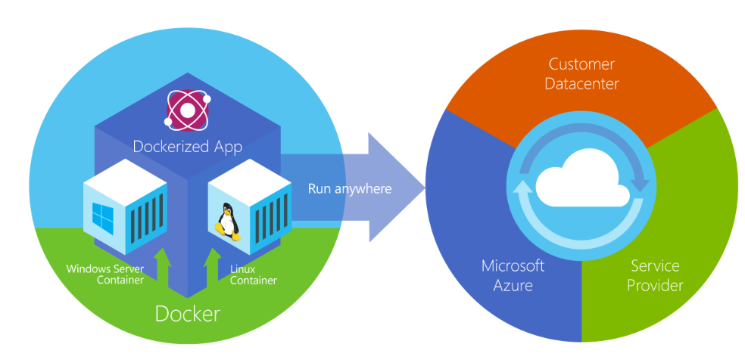
Docker
Allows you to package an application with all of its dependencies into a standardized unit for software development and deployment.

Slide 3
Why?
Build once... run anywhere!
Portable runtime environment for your app
No worries about missing dependencies, packages and other pain points
Run each app in its own isolated container, so you can run various versions of libraries and other dependencies for each app
Automate testing, integration, packaging...anything you can script.
Reduce/eliminate concerns about compatibility on different platforms

Slide 4
Key Terms
Dockerfile – the recipe/specification for an image
Docker Image – The basis of a Docker container. Represents a full application.
Docker Container – Where the application/service lives and executes
Docker Engine – builds, ships, and runs the containers
Registry (e.g. Docker Hub) – storage and distribution for your images
https://hub.docker.com/r/opendrr/python-env

Slide 5
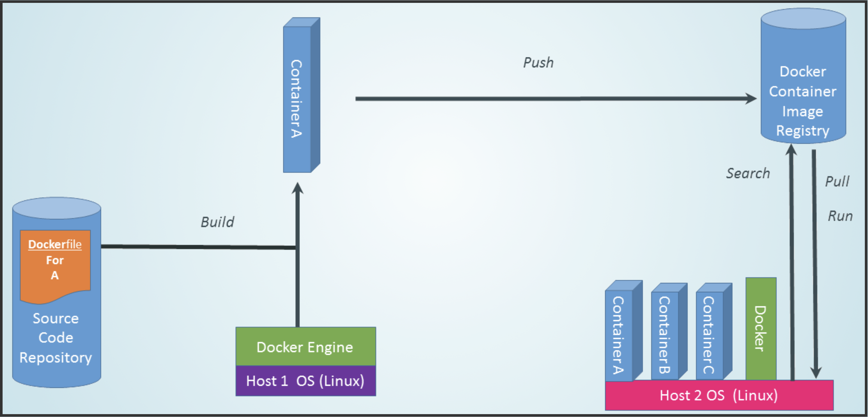
Docker Ecosystem

Slide 6
Key commands
docker run – Runs a command in a new container.
docker start – Starts one or more stopped containers
docker stop – Stops one or more running containers
docker build – Builds an image form a Docker file
docker pull – Pulls an image or a repository from a registry
docker ps – list running containers. Use –a flag to see all containers
docker images – list images

Slide 7
Hands on - Set up GeoServer in 2 steps
$ docker pull kartoza/geoserver
$ docker run -d --name "geoserver" -p 8080:8080 kartoza/geoserver
http://localhost:8080/geoserver [Username/PW: admin/geoserver]
Stopping the application
$ docker ps (find the container name)
$ docker stop geoserver
Restarting
$ docker start geoserver
Setup Ubuntu in 1 step
$ docker run -i -t ubuntu /bin/bash

Slide 8
Docker Compose
Compose is a tool for defining and running multi-container Docker applications.
Use a YAML file to configure your application’s services
Use a single command, to create and start all the services for your application
Excellent for:
Development environments
Automated testing environments
Single host deployments

Slide 9
Docker Compose Commands
docker-compose up – bring up an application stack
docker-compose down – bring down an application stack
docker-compose up --build – build images (Dockerfile’s) and bring up an application stack

Slide 10
Live walkthrough of stack configuration

